Slide 1
Modelling, simulation and control of liquid level in a tank.
Anthony Rossiter

Slide 2
Scenario
A tank has liquid to depth ‘h’.
There is liquid flowing in.
There is liquid flowing out.
Determine a model for the depth of liquid in the tank.

Slide 3
Modelling 1
The flow out will depend upon the pressure in the tank which depends upon the depth (and a constant linked to density and pipe shape).
The rate of change of depth will depend on the cross-sectional area.
The rate of change of depth will depend on the difference between flow in and flow out.

Slide 4
Adding control
An observer monitors the depth and modifies the flow in to keep the depth at the target level.
Hence the flow in is determined from the standard proportional + integral law.

Slide 5
Modelling 2
The control law needs to be included in the model.

Slide 6
Modelling 3
Finally the model is simplified to a standard 2nd order ODE.
NOTE: Clearly the dynamics depend upon the control law parameters which hence need to be selected appropriately to get the desired response.
For practical reasons it is common place to ignore the differential of the target when the target undergoes step changes.

Slide 7
Simulating the model
First determine values for the Area and other constants.
Choose a target and initial depth.
Investigate how the response changes as the control law parameters are changed.
What sort of response is reasonable?
Remember, in practice the in-flow will be upper limited so, as with filling a bath, you can only do it so quick!

Slide 8
Numerical example
A=50
Rgρ=1
Ki=0.1
Kp=1

Slide 9
Algebraic solution
By inspection, as t tends to infinity and derivatives go to zero, then h=r. Hence B=1;
MATLAB CODE
Ht=dsolve('50*D2h+2*Dh+0.2*h=0.2*r','Dh(0)=0','h(0)=0.2')

Slide 10
Plot of responses

Slide 11
Questions
What is the impact of changing Kp on behaviour? Determine this from the ODE and looking at the solutions.
What is the impact of changing Ki on behaviour? Determine this from the ODE and looking at the solutions.
Can you show what you never reach the target when Ki=0? Note with Ki=0, ODE reduces to:
Generate fast numerical solutions using the MATLAB GUI (see next page) to check your answers and insights.

Slide 12
Running simulation yourself
Use the MATLAB GUI file (you need the tanklevelanimation2.fig file in the same folder):
tanklevelanimation2.p
This is a GUI with no inputs and outputs. You can change the parameters and investigate behaviour changes as you do so.
Initial depth, target, runtime, Ki and Kp are limited to sensible values. Tank attributes are taken as fixed.

Slide 13
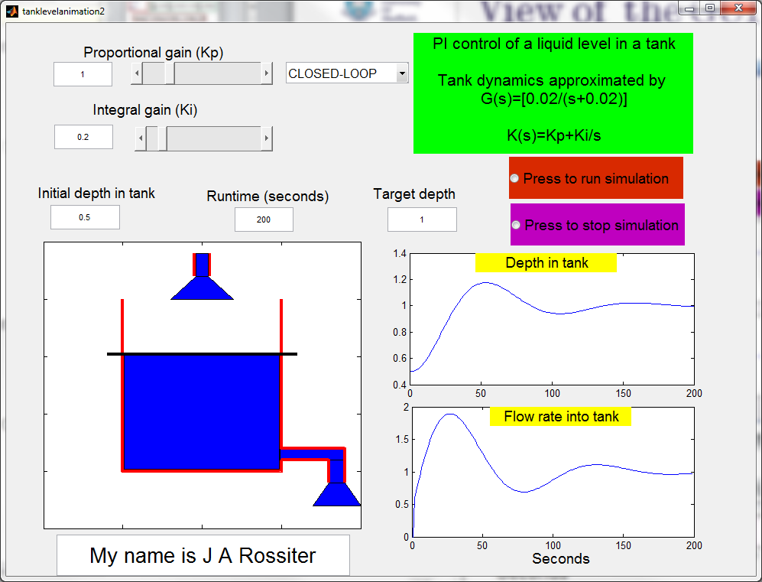
View of the GUI
You can choose open-loop response or closed-loop.
Open-loop ignores the control parameters.

